Slide 1
Computer Architecture
A Quantitative Approach, Sixth Edition
Chapter 2
Memory Hierarchy Design

Slide 2
Introduction
Introduction
Programmers want unlimited amounts of memory with low latency
Fast memory technology is more expensive per bit than slower memory
Solution: organize memory system into a hierarchy
Entire addressable memory space available in largest, slowest memory
Incrementally smaller and faster memories, each containing a subset of the memory below it, proceed in steps up toward the processor
Temporal and spatial locality insures that nearly all references can be found in smaller memories
Gives the allusion of a large, fast memory being presented to the processor

Slide 3
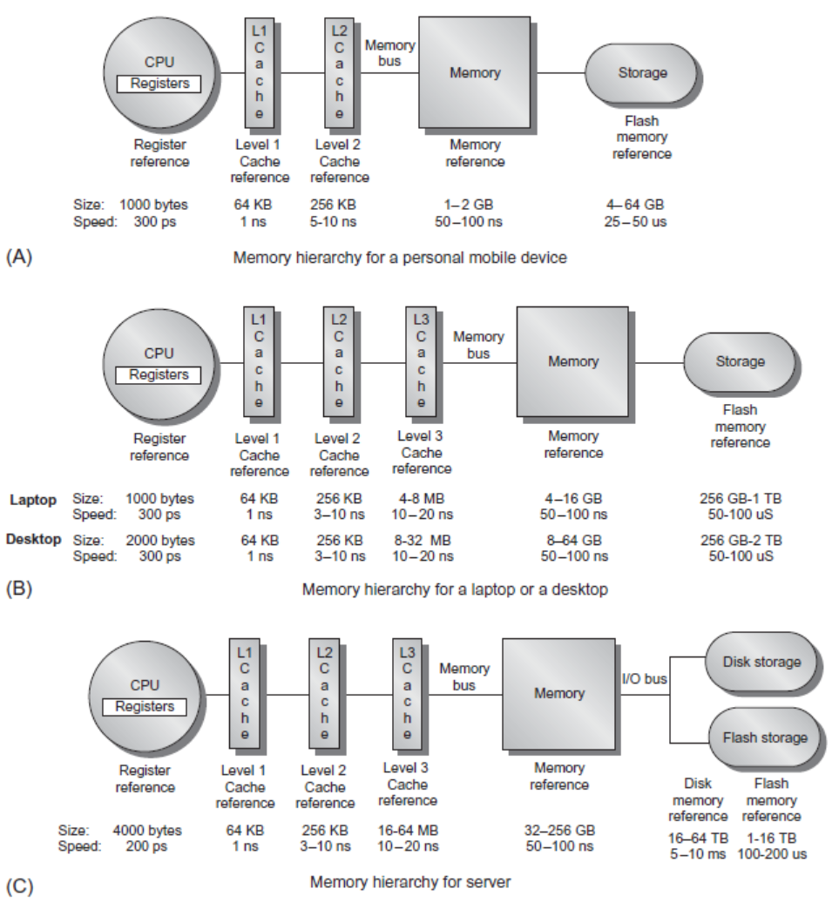
Memory Hierarchy
Introduction

Slide 4
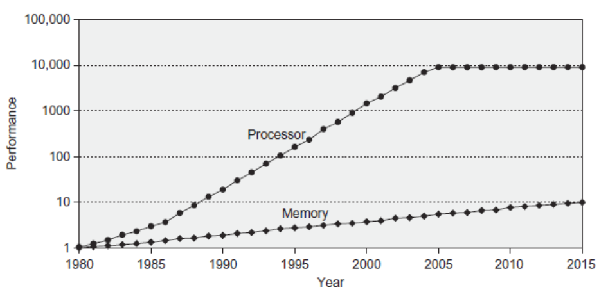
Memory Performance Gap
Introduction

Slide 5
Memory Hierarchy Design
Introduction
Memory hierarchy design becomes more crucial with recent multi-core processors:
Aggregate peak bandwidth grows with # cores:
Intel Core i7 can generate two references per core per clock
Four cores and 3.2 GHz clock
25.6 billion 64-bit data references/second +
12.8 billion 128-bit instruction references/second
= 409.6 GB/s!
DRAM bandwidth is only 8% of this (34.1 GB/s)
Requires:
Multi-port, pipelined caches
Two levels of cache per core
Shared third-level cache on chip

Slide 6
Performance and Power
Introduction
High-end microprocessors have >10 MB on-chip cache
Consumes large amount of area and power budget

Slide 7
Memory Hierarchy Basics
Introduction
When a word is not found in the cache, a miss occurs:
Fetch word from lower level in hierarchy, requiring a higher latency reference
Lower level may be another cache or the main memory
Also fetch the other words contained within the block
Takes advantage of spatial locality
Place block into cache in any location within its set, determined by address
block address MOD number of sets in cache

Slide 8
Memory Hierarchy Basics
Introduction
n sets => n-way set associative
Direct-mapped cache => one block per set
Fully associative => one set
Writing to cache: two strategies
Write-through
Immediately update lower levels of hierarchy
Write-back
Only update lower levels of hierarchy when an updated block is replaced
Both strategies use write buffer to make writes asynchronous

Slide 9
Memory Hierarchy Basics
Introduction
Miss rate
Fraction of cache access that result in a miss
Causes of misses
Compulsory
First reference to a block
Capacity
Blocks discarded and later retrieved
Conflict
Program makes repeated references to multiple addresses from different blocks that map to the same location in the cache

Slide 10
Memory Hierarchy Basics
Introduction
Speculative and multithreaded processors may execute other instructions during a miss
Reduces performance impact of misses

Slide 11
Memory Hierarchy Basics
Introduction
Six basic cache optimizations:
Larger block size
Reduces compulsory misses
Increases capacity and conflict misses, increases miss penalty
Larger total cache capacity to reduce miss rate
Increases hit time, increases power consumption
Higher associativity
Reduces conflict misses
Increases hit time, increases power consumption
Higher number of cache levels
Reduces overall memory access time
Giving priority to read misses over writes
Reduces miss penalty
Avoiding address translation in cache indexing
Reduces hit time

Slide 12
Memory Technology and Optimizations
Performance metrics
Latency is concern of cache
Bandwidth is concern of multiprocessors and I/O
Access time
Time between read request and when desired word arrives
Cycle time
Minimum time between unrelated requests to memory
SRAM memory has low latency, use for cache
Organize DRAM chips into many banks for high bandwidth, use for main memory
Memory Technology and Optimizations

Slide 13
Memory Technology
SRAM
Requires low power to retain bit
Requires 6 transistors/bit
DRAM
Must be re-written after being read
Must also be periodically refeshed
Every ~ 8 ms (roughly 5% of time)
Each row can be refreshed simultaneously
One transistor/bit
Address lines are multiplexed:
Upper half of address: row access strobe (RAS)
Lower half of address: column access strobe (CAS)
Memory Technology and Optimizations

Slide 14
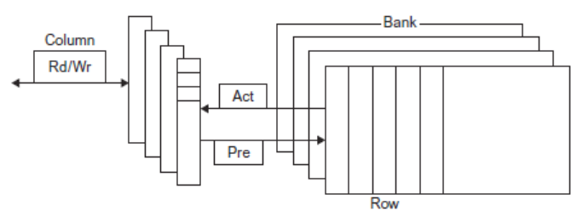
Internal Organization of DRAM
Memory Technology and Optimizations

Slide 15
Memory Technology
Amdahl:
Memory capacity should grow linearly with processor speed
Unfortunately, memory capacity and speed has not kept pace with processors
Some optimizations:
Multiple accesses to same row
Synchronous DRAM
Added clock to DRAM interface
Burst mode with critical word first
Wider interfaces
Double data rate (DDR)
Multiple banks on each DRAM device
Memory Technology and Optimizations

Slide 16
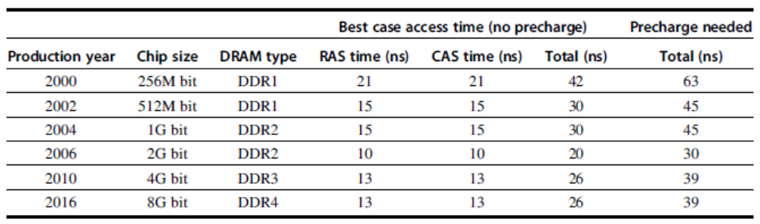
Memory Optimizations
Memory Technology and Optimizations

Slide 17
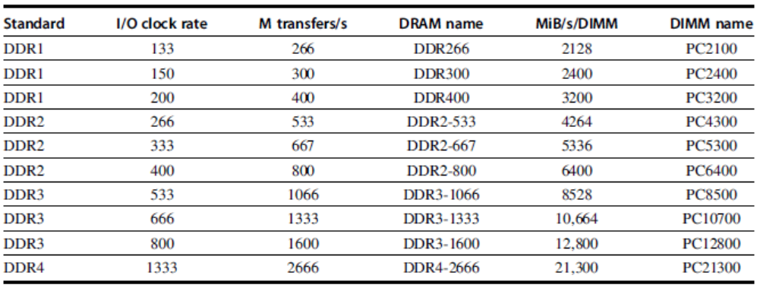
Memory Optimizations
Memory Technology and Optimizations

Slide 18
Memory Optimizations
DDR:
DDR2
Lower power (2.5 V -> 1.8 V)
Higher clock rates (266 MHz, 333 MHz, 400 MHz)
DDR3
1.5 V
800 MHz
DDR4
1-1.2 V
1333 MHz
GDDR5 is graphics memory based on DDR3
Memory Technology and Optimizations

Slide 19
Memory Optimizations
Reducing power in SDRAMs:
Lower voltage
Low power mode (ignores clock, continues to refresh)
Graphics memory:
Achieve 2-5 X bandwidth per DRAM vs. DDR3
Wider interfaces (32 vs. 16 bit)
Higher clock rate
Possible because they are attached via soldering instead of socketted DIMM modules
Memory Technology and Optimizations

Slide 20
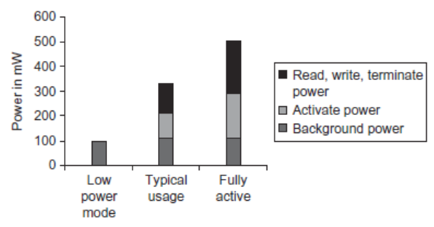
Memory Power Consumption
Memory Technology and Optimizations

Slide 21
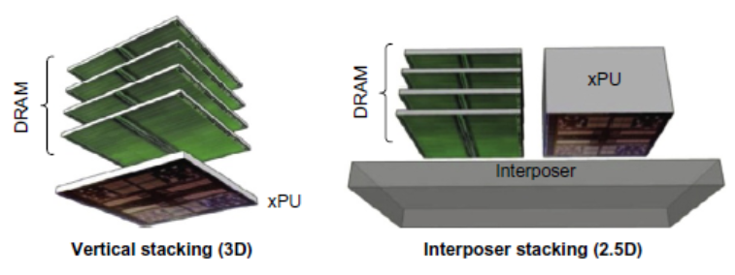
Stacked/Embedded DRAMs
Stacked DRAMs in same package as processor
High Bandwidth Memory (HBM)
Memory Technology and Optimizations

Slide 22
Flash Memory
Type of EEPROM
Types: NAND (denser) and NOR (faster)
NAND Flash:
Reads are sequential, reads entire page (.5 to 4 KiB)
25 us for first byte, 40 MiB/s for subsequent bytes
SDRAM: 40 ns for first byte, 4.8 GB/s for subsequent bytes
2 KiB transfer: 75 uS vs 500 ns for SDRAM, 150X slower
300 to 500X faster than magnetic disk
Memory Technology and Optimizations

Slide 23
NAND Flash Memory
Must be erased (in blocks) before being overwritten
Nonvolatile, can use as little as zero power
Limited number of write cycles (~100,000)
$2/GiB, compared to $20-40/GiB for SDRAM and $0.09 GiB for magnetic disk
Phase-Change/Memrister Memory
Possibly 10X improvement in write performance and 2X improvement in read performance
Memory Technology and Optimizations

Slide 24
Memory Dependability
Memory is susceptible to cosmic rays
Soft errors: dynamic errors
Detected and fixed by error correcting codes (ECC)
Hard errors: permanent errors
Use spare rows to replace defective rows
Chipkill: a RAID-like error recovery technique
Memory Technology and Optimizations

Slide 25
Advanced Optimizations
Reduce hit time
Small and simple first-level caches
Way prediction
Increase bandwidth
Pipelined caches, multibanked caches, non-blocking caches
Reduce miss penalty
Critical word first, merging write buffers
Reduce miss rate
Compiler optimizations
Reduce miss penalty or miss rate via parallelization
Hardware or compiler prefetching
Advanced Optimizations

Slide 26
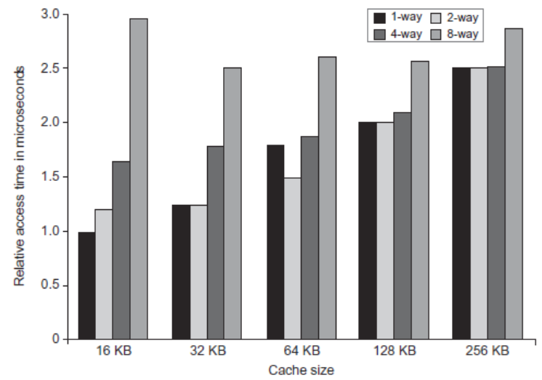
L1 Size and Associativity
Advanced Optimizations
Access time vs. size and associativity

Slide 27
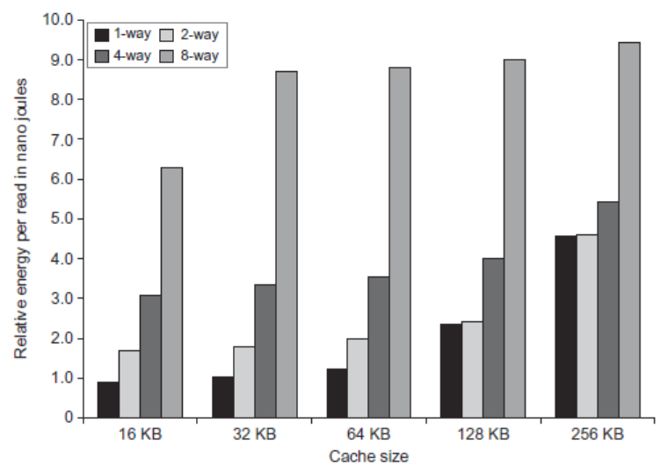
L1 Size and Associativity
Advanced Optimizations
Energy per read vs. size and associativity

Slide 28
Way Prediction
To improve hit time, predict the way to pre-set mux
Mis-prediction gives longer hit time
Prediction accuracy
> 90% for two-way
> 80% for four-way
I-cache has better accuracy than D-cache
First used on MIPS R10000 in mid-90s
Used on ARM Cortex-A8
Extend to predict block as well
“Way selection”
Increases mis-prediction penalty
Advanced Optimizations

Slide 29
Pipelined Caches
Pipeline cache access to improve bandwidth
Examples:
Pentium: 1 cycle
Pentium Pro – Pentium III: 2 cycles
Pentium 4 – Core i7: 4 cycles
Increases branch mis-prediction penalty
Makes it easier to increase associativity
Advanced Optimizations

Slide 30
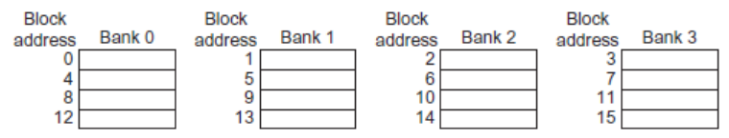
Multibanked Caches
Organize cache as independent banks to support simultaneous access
ARM Cortex-A8 supports 1-4 banks for L2
Intel i7 supports 4 banks for L1 and 8 banks for L2
Interleave banks according to block address
Advanced Optimizations

Slide 31
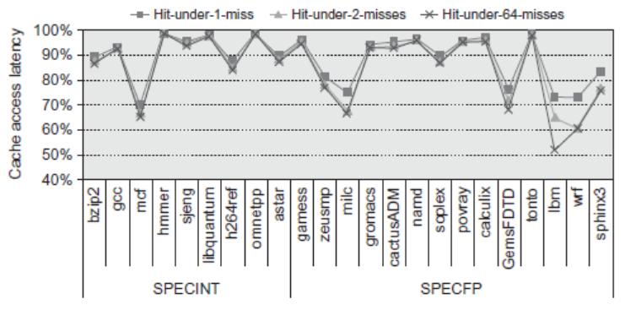
Nonblocking Caches
Allow hits before previous misses complete
“Hit under miss”
“Hit under multiple miss”
Do not stall during data miss, fetch instructions
Can be used for out-of-order processors (next chapter)
Advanced Optimizations

Slide 32
Critical Word First, Early Restart
Critical word first
Request missed word from memory first
Send it to the processor as soon as it arrives
Early restart
Request words in normal order
Send missed work to the processor as soon as it arrives
Effectiveness of these strategies depends on block size and likelihood of another access to the portion of the block that has not yet been fetched
Advanced Optimizations

Slide 33
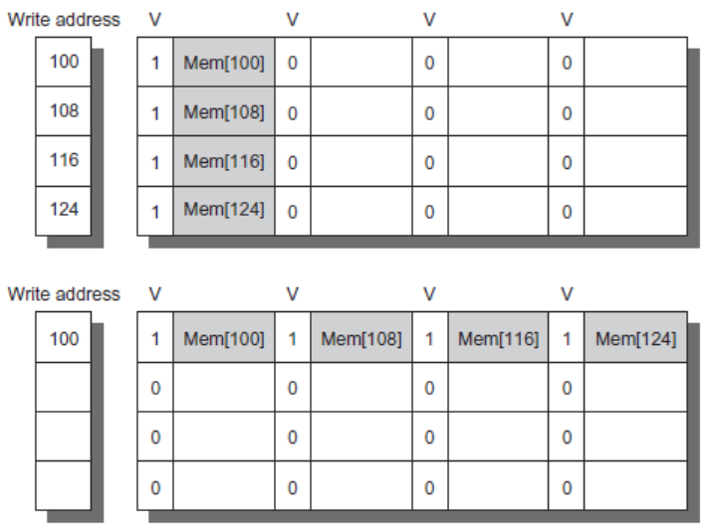
Merging Write Buffer
When storing to a block that is already pending in the write buffer, update write buffer
Reduces stalls due to full write buffer
Do not apply to I/O addresses
Advanced Optimizations
No merging write buffering
Merging Write buffering

Slide 34
Compiler Optimizations
Loop Interchange
Swap nested loops to access memory in sequential order
Blocking
Instead of accessing entire rows or columns, subdivide matrices into blocks
Requires more memory accesses but improves locality of accesses
Advanced Optimizations

Slide 35
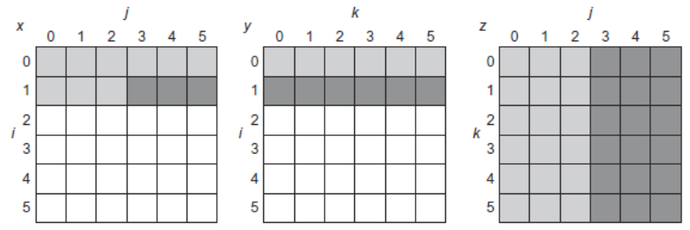
Blocking
for (i = 0; i < N; i = i + 1)
for (j = 0; j < N; j = j + 1)
{
r = 0;
for (k = 0; k < N; k = k + 1)
r = r + y[i][k]*z[k][j];
x[i][j] = r;
};

Slide 36
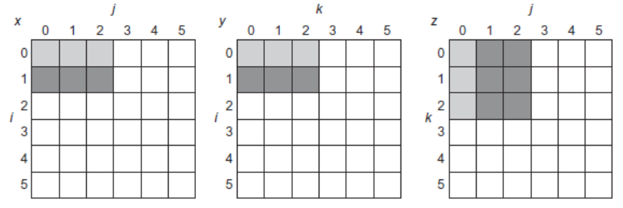
Blocking
for (jj = 0; jj < N; jj = jj + B)
for (kk = 0; kk < N; kk = kk + B)
for (i = 0; i < N; i = i + 1)
for (j = jj; j < min(jj + B,N); j = j + 1)
{
r = 0;
for (k = kk; k < min(kk + B,N); k = k + 1)
r = r + y[i][k]*z[k][j];
x[i][j] = x[i][j] + r;
};

Slide 37
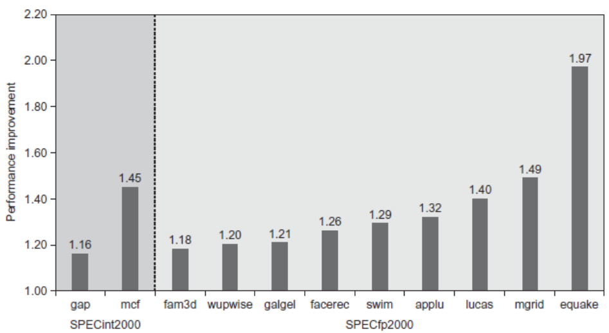
Hardware Prefetching
Fetch two blocks on miss (include next sequential block)
Advanced Optimizations
Pentium 4 Pre-fetching

Slide 38
7. Compiler Optimizations
McFarling [1989] reduced caches misses by 75% on 8KB direct mapped cache, 4 byte blocks in software
Instructions
Reorder procedures in memory so as to reduce conflict misses
Profiling to look at conflicts(using tools they developed)
Data
Merging Arrays: improve spatial locality by single array of compound elements vs. 2 arrays
Loop Interchange: change nesting of loops to access data in order stored in memory
Loop Fusion: Combine 2 independent loops that have same looping and some variables overlap
Blocking: Improve temporal locality by accessing “blocks” of data repeatedly vs. going down whole columns or rows

Slide 39
Merging Arrays Example
/* Before: 2 sequential arrays */
int val[SIZE];
int key[SIZE];
/* After: 1 array of stuctures */
struct merge {
int val;
int key;
};
struct merge merged_array[SIZE];
Reducing conflicts between val & key; improve spatial locality

Slide 40
Loop Interchange Example
/* Before */
for (k = 0; k < 100; k = k+1)
for (j = 0; j < 100; j = j+1)
for (i = 0; i < 5000; i = i+1)
x[i][j] = 2 * x[i][j];
/* After */
for (k = 0; k < 100; k = k+1)
for (i = 0; i < 5000; i = i+1)
for (j = 0; j < 100; j = j+1)
x[i][j] = 2 * x[i][j];
Sequential accesses instead of striding through memory every 100 words; improved spatial locality

Slide 41
Loop Fusion Example
/* Before */
for (i = 0; i < N; i = i+1)
for (j = 0; j < N; j = j+1)
a[i][j] = 1/b[i][j] * c[i][j];
for (i = 0; i < N; i = i+1)
for (j = 0; j < N; j = j+1)
d[i][j] = a[i][j] + c[i][j];
/* After */
for (i = 0; i < N; i = i+1)
for (j = 0; j < N; j = j+1)
{ a[i][j] = 1/b[i][j] * c[i][j];
d[i][j] = a[i][j] + c[i][j];}
2 misses per access to a & c vs. one miss per access; improve spatial locality

Slide 42
Blocking Example
/* Before */
for (i = 0; i < N; i = i+1)
for (j = 0; j < N; j = j+1){
r = 0;
for (k = 0; k < N; k = k+1){
r = r + y[i][k]*z[k][j];
}
x[i][j] = r;
}
Two Inner Loops:
Read all NxN elements of z[]
Read N elements of 1 row of y[] repeatedly
Write N elements of 1 row of x[]
Capacity Misses a function of N & Cache Size:
2N³ + N² => (assuming no conflict; otherwise …)
Idea: compute on BxB submatrix that fits

Slide 43
Blocking Example
/* After */
for (jj = 0; jj < N; jj = jj+B)
for (kk = 0; kk < N; kk = kk+B)
for (i = 0; i < N; i = i+1)
for (j = jj; j < min(jj+B-1,N); j = j+1) {
r = 0;
for (k = kk; k < min(kk+B-1,N); k = k+1) {
r = r + y[i][k]*z[k][j];
}
x[i][j] = x[i][j] + r;
}
B called Blocking Factor
Capacity Misses from 2N³ + N² to 2N³/B +N²
Conflict Misses Too?

Slide 44
Compiler Optimizations

Slide 45
Compiler Prefetching
Insert prefetch instructions before data is needed
Non-faulting: prefetch doesn’t cause exceptions
Register prefetch
Loads data into register
Cache prefetch
Loads data into cache
Combine with loop unrolling and software pipelining
Advanced Optimizations

Slide 46
Use HBM to Extend Hierarchy
128 MiB to 1 GiB
Smaller blocks require substantial tag storage
Larger blocks are potentially inefficient
One approach (L-H):
Each SDRAM row is a block index
Each row contains set of tags and 29 data segments
29-set associative
Hit requires a CAS
Advanced Optimizations

Slide 47
Use HBM to Extend Hierarchy
Another approach (Alloy cache):
Mold tag and data together
Use direct mapped
Both schemes require two DRAM accesses for misses
Two solutions:
Use map to keep track of blocks
Predict likely misses
Advanced Optimizations

Slide 48
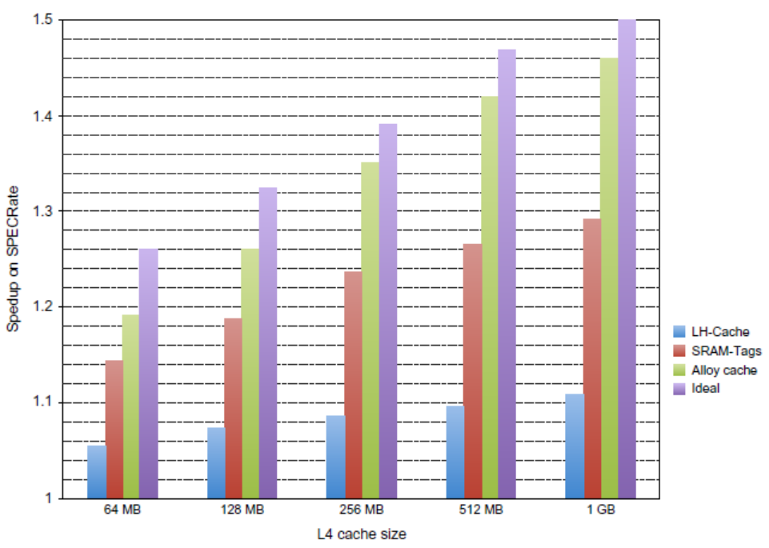
Use HBM to Extend Hierarchy
Advanced Optimizations

Slide 49
1. Reduce Misses via Larger Block Size
-Compulsory
+Conflict & +Capacity
+Miss Penalty

Slide 50
2. Higher Associativity
2:1 Cache Rule:
Miss Rate DM cache size N ~ Miss Rate 2-way cache size N/2
Holds for < 128KB
8 Way as effective as Fully SA
Execution time is only final measure!
Will Clock Cycle time increase?
external cache +10%,
internal + 2%

Slide 51
3. “Victim Cache”
Combine fast hit time of direct mapped while avoiding conflict misses
Add buffer (small fully SA Cache) to place data discarded from cache (Victim)
Jouppi [1990]: 4-entry victim cache removed 20% to 95% of conflicts for a 4 KB direct mapped data cache
Used in Alpha, HP machines
TAGS
DATA
Tag and Comparator
One Cache line of Data
Tag and Comparator
One Cache line of Data
Tag and Comparator
One Cache line of Data
Tag and Comparator
One Cache line of Data
To Next Lower Level In
Hierarchy

Slide 52
4. “Pseudo-Associativity”
Combine fast hit time of Direct Mapped and have the lower conflict misses of 2-way SA cache
Divide cache: on a miss, check other half of cache to see if there, if so have a pseudo-hit (slow hit)
Drawback: CPU pipeline is hard if hit takes 1 or 2 cycles
Better for caches not tied directly to processor (L2)
Used in MIPS R1000 L2 cache, similar in UltraSPARC
Hit Time
Pseudo Hit Time
Miss Penalty
Time

Slide 53
5. Hardware Prefetching
E.g., Instruction Prefetching
Alpha 21064 fetches 2 blocks on a miss
Extra block placed in “stream buffer”
On miss check stream buffer
Works with data blocks too:
Jouppi [1990] 1 data stream buffer got 25% misses from 4KB cache; 4 streams got 43%
Palacharla & Kessler [1994] for scientific programs for 8 streams got 50% to 70% of misses from 2 64KB, 4-way set associative caches
Prefetching relies on having extra memory bandwidth that can be used without penalty

Slide 54
6. Software Prefetching
Data Prefetch
Load data into register (HP PA-RISC loads)
Cache Prefetch: load into cache (MIPS IV, PowerPC, SPARC v. 9)
Special prefetching instructions cannot cause faults; a form of speculative execution
Issuing Prefetch Instructions takes time
Is cost of prefetch issues < savings in reduced misses?
Higher superscalar reduces difficulty of issue bandwidth

Slide 55
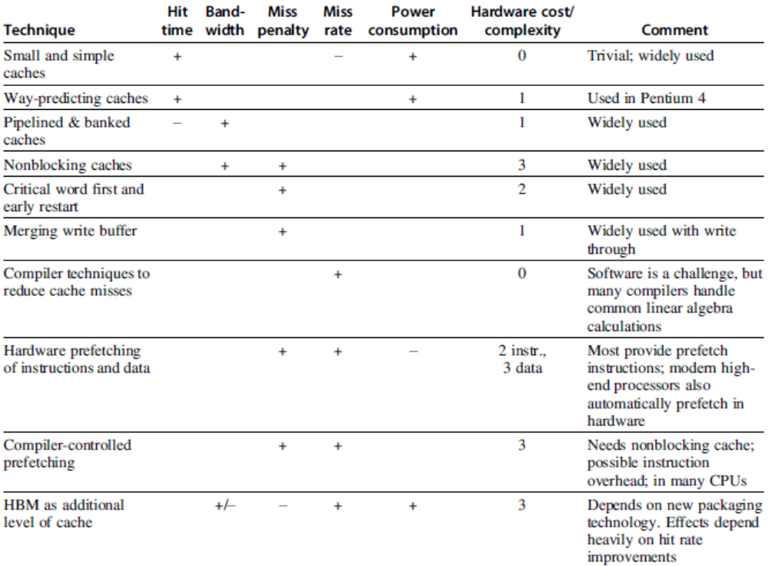
Summary
Advanced Optimizations

